Slide 1
Day 4
Effective Implementation of
MITRE ATT&CK Framework
Presented by: Aditya Jamkhande

Slide 2
Something About Me
Experience:
10+ years in Cybersecurity
Security Analysis
Incident Handling and response
Security Architecture and Strategy
SIEM Engineering
Vulnerability management
SOAR
Project Delivered in:
India
Australia
Belgium
Socials:
LinkedIn: https://www.linkedin.com/in/aditya-j-8a246368
Twitter Handle: @ADITYAJAMKHANDE
Current Company:
Euroclear, Belgium

Slide 3
Challenging Questions for Defenders
How effective are my defenses?
Do I have a chance at detecting APT29 or APT28 or any other adversary group?
Is the data I’m collecting useful?
Do I have overlapping tool coverage?
Will this new product/technology help my organization’s defenses?
How can I strategize my defences and strengthen the security posture?

Slide 4
What is MITRE ATT&CK ?
ATT&CK is a knowledge base of cyber adversary behavior and taxonomy for adversarial actions across their lifecycle.
ATT&CK has two parts:
ATT&CK for Enterprise: which covers behavior against enterprise IT networks and cloud.
ATT&CK for Mobile: which focuses on behavior against mobile devices.

Slide 5
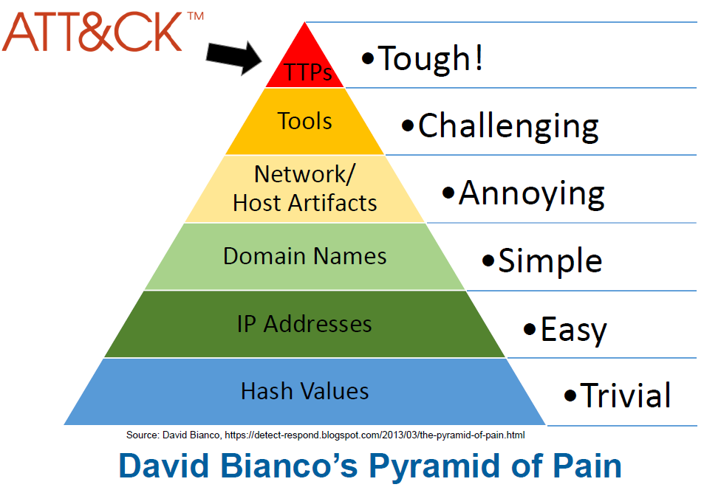
David Bianco’s Pyramid of Pain

Slide 6
Why did MITRE develop ATT&CK?
MITRE started ATT&CK in 2013 to document common tactics, techniques, and procedures (TTPs)
It was created out of a need to document adversary behaviors for use within a MITRE research project called FMX
Investigate use of endpoint telemetry data and analytics to improve post-compromise detection of adversaries operating within enterprise networks
ATT&CK was used as the basis for testing the efficacy of the sensors and analytics under FMX
Served as the common language which both offense and defense could use to improve over time

Slide 7
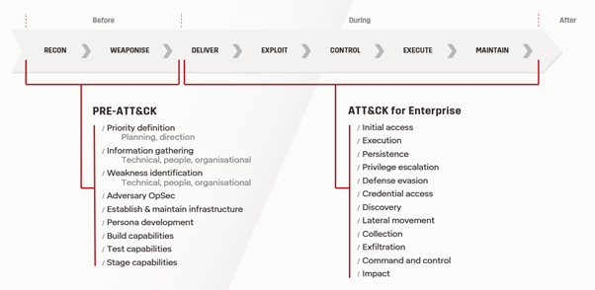
Overview of the Adversary Lifecycle

Slide 8
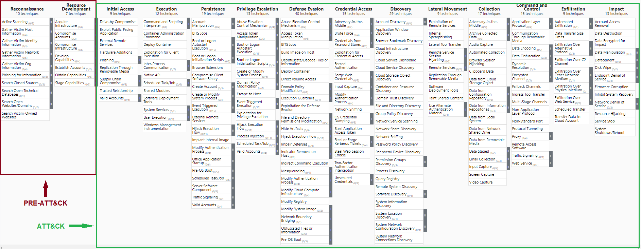
Overview of the Adversary Lifecycle

Slide 9
What are "tactics", "techniques", "sub-techniques" and "procedures"?
Tactics:
Tactics represent the “why” of an ATT&CK technique or sub-technique
It is the adversary’s tactical goal: the reason for performing an action
Example: An adversary may want to achieve credential access
Techniques:
Techniques represent “how” an adversary achieves a tactical goal by performing an action
Example: an adversary may dump credentials to achieve credential access
Sub-techniques:
Sub-techniques are a more specific description of the adversarial behavior used to achieve a goal
They describe behavior at a lower level than a technique
Example: an adversary may dump credentials by accessing the Local Security Authority (LSA) Secrets
Procedures:
Procedures are the specific implementation that the adversary uses for techniques or sub-techniques
These are categorized in ATT&CK as the observed in the wild use of techniques in the "Procedure Examples" section of technique pages

Slide 10
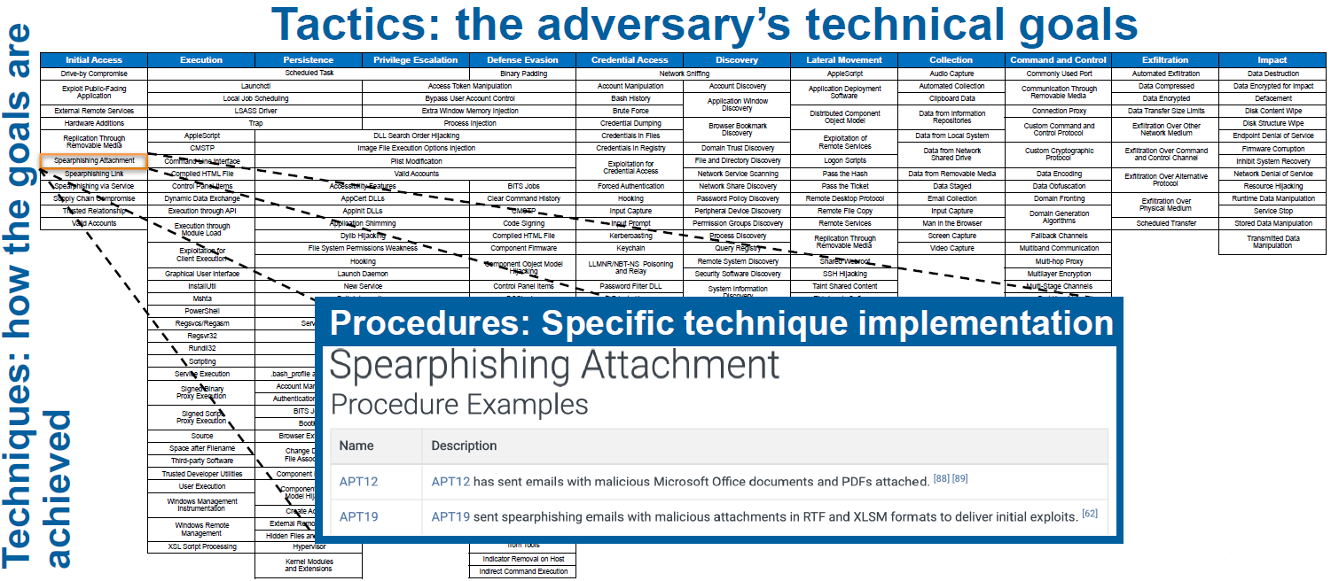
What are "tactics", "techniques", "sub-techniques" and "procedures"?

Slide 11
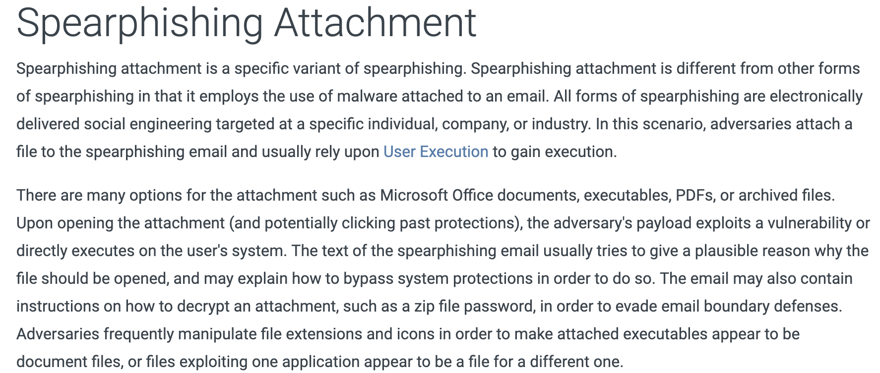
Technique: Spearphishing Attachment

Slide 12
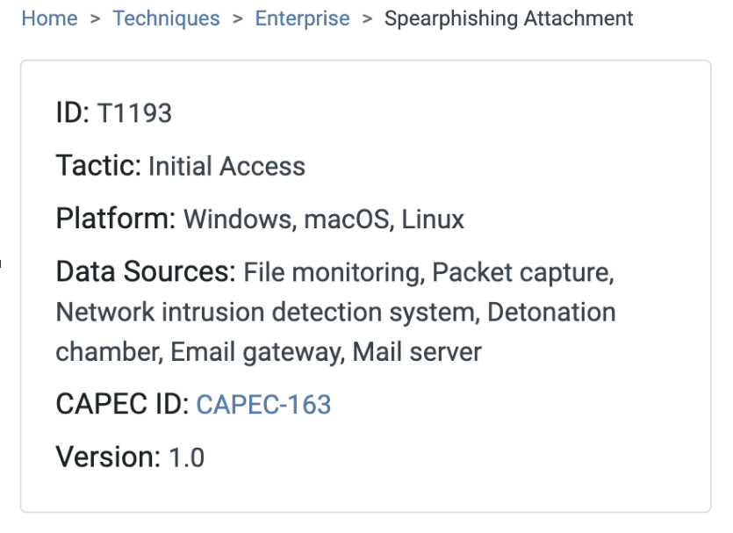
Technique: Spearphishing Attachment

Slide 13
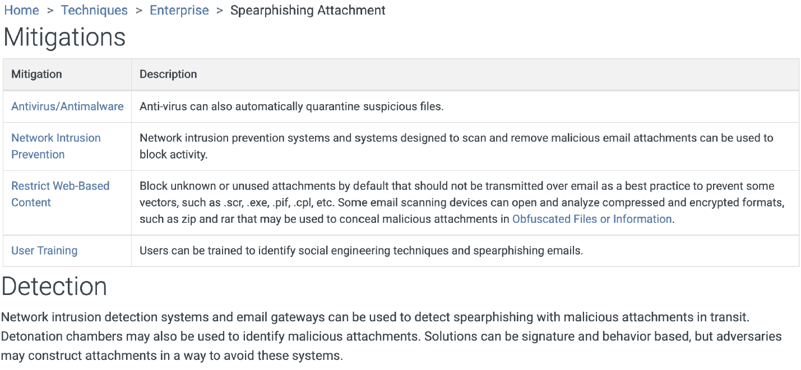
Technique: Spearphishing Attachment

Slide 14
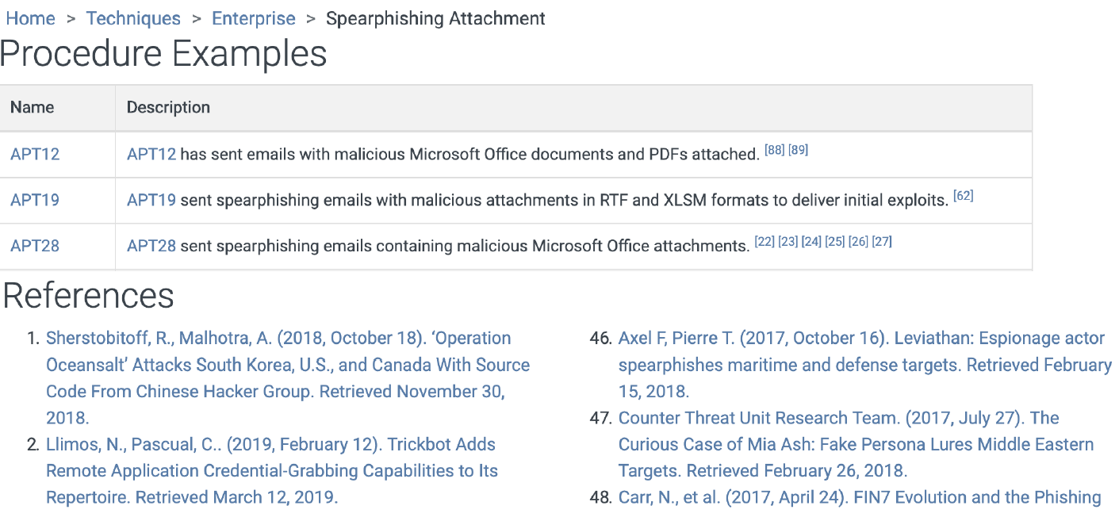
Technique: Spearphishing Attachment

Slide 15
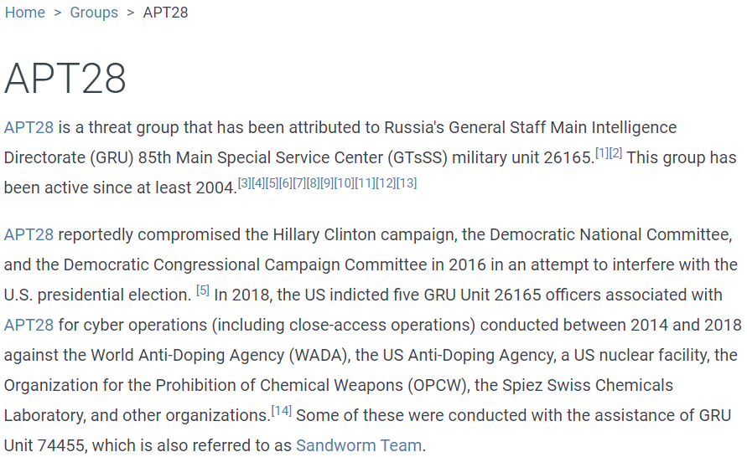
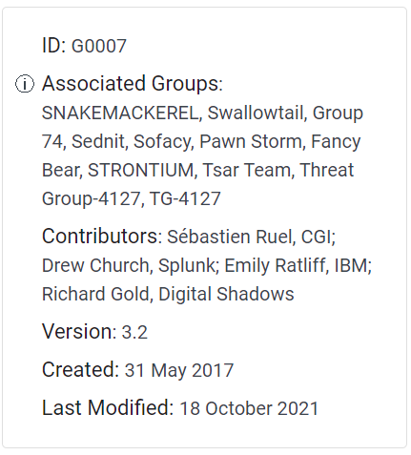
Group: APT28

Slide 16
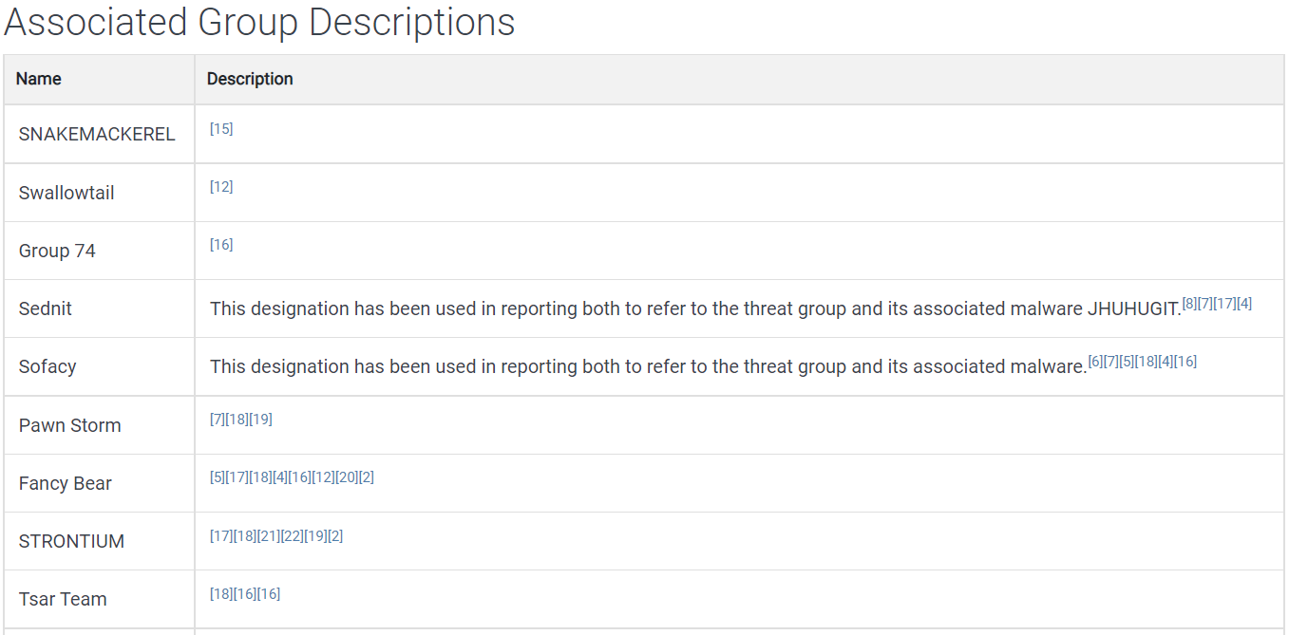
Group: APT28

Slide 17
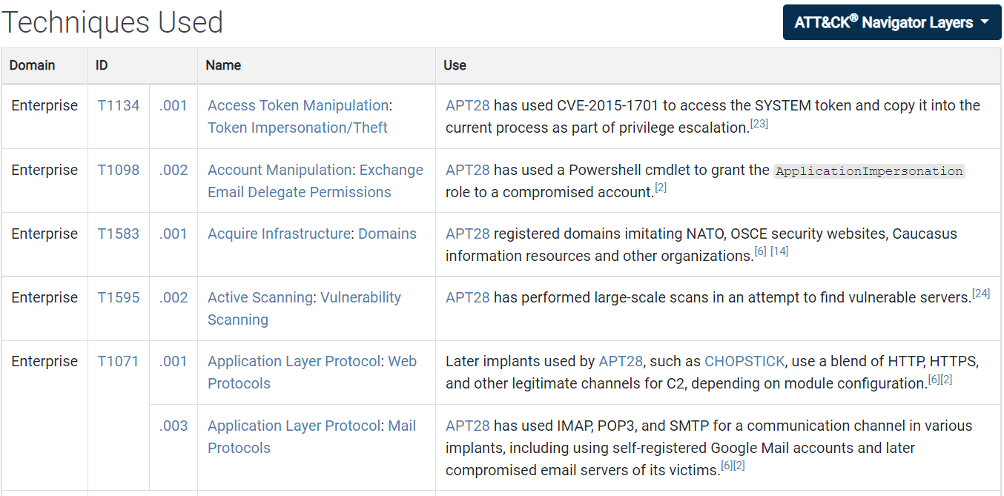
Group: APT28

Slide 18
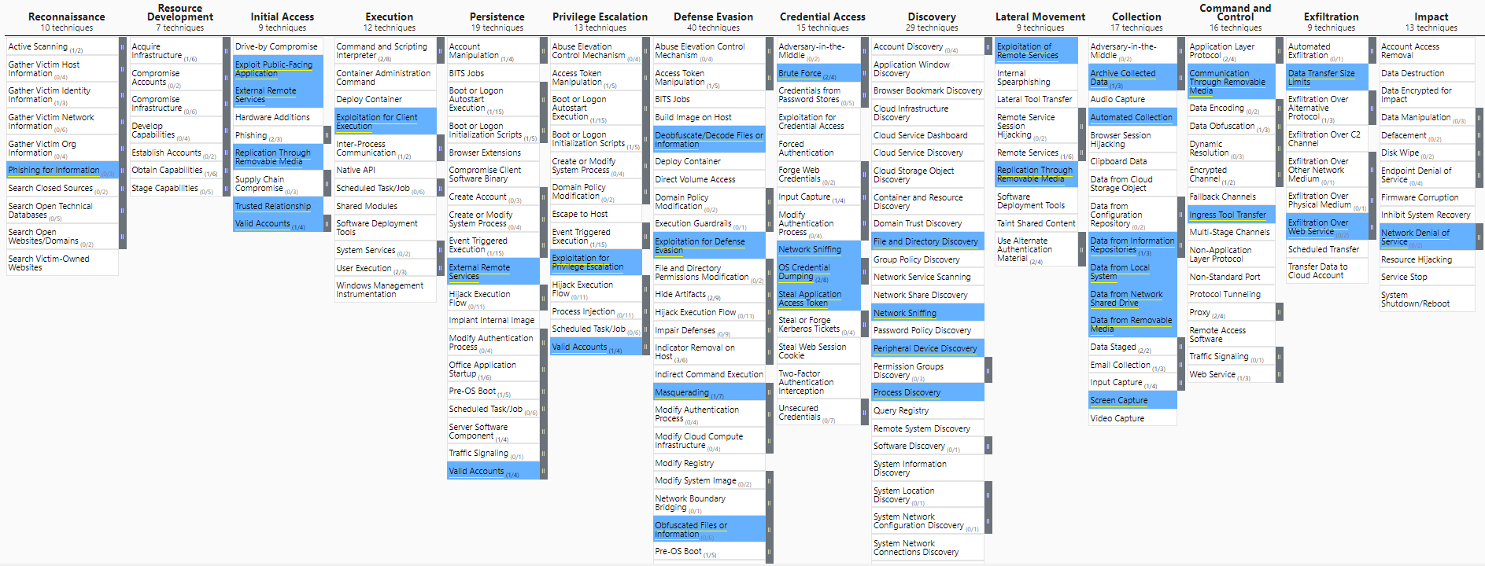
Group: APT28

Slide 19
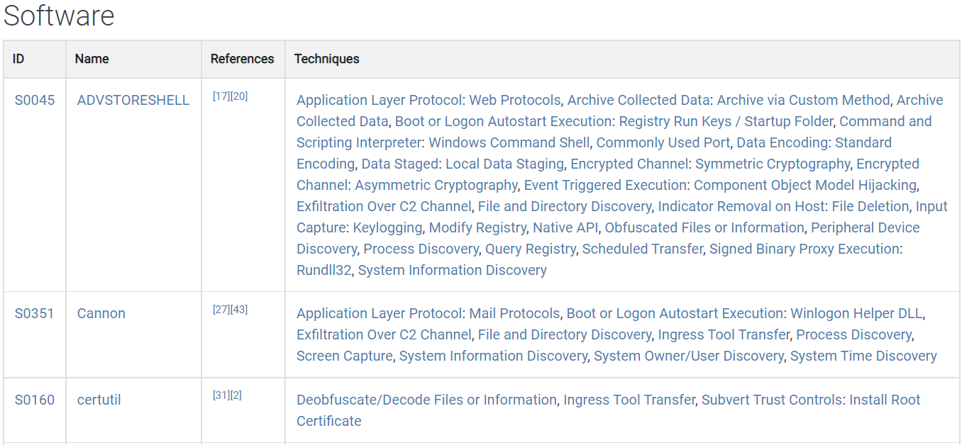
Group: APT28

Slide 20
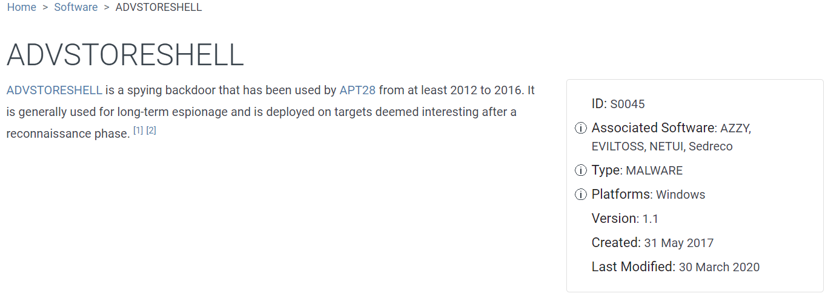
Group: APT28

Slide 21
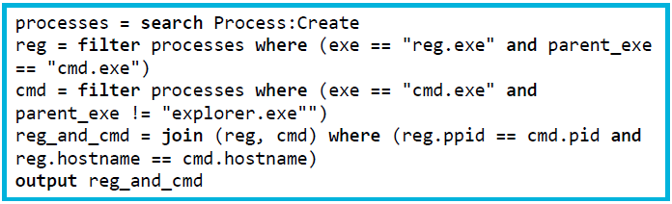
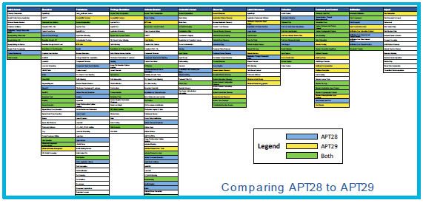
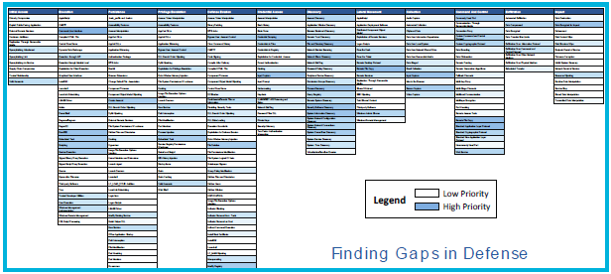
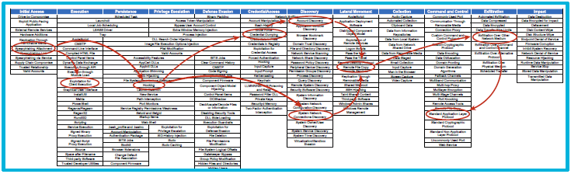
ATT&CK Use Cases
Detection
Threat Intelligence
Assessment and Engineering
Adversary Emulation

Slide 22
Detection: Find the Behavior
Different mindset from looking for indicators
Look for what the adversary or software does
Focus on initial compromise and post-compromise details
Info that may not be useful for ATT&CK mapping:
Static malware analysis
Infrastructure registration information
Industry/victim targeting information

Slide 23
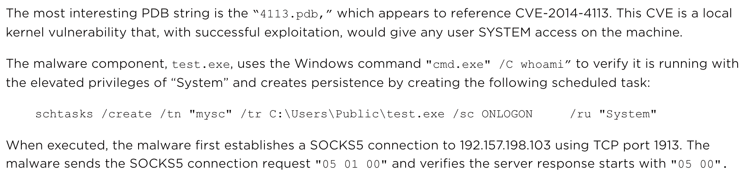
Detection: Find the Behavior

Slide 24
Detection: Research the Behavior
CTI analysts may not be familiar with adversary/software behavior
Encourage them to do additional research:
of your own team or organization (defenders/red teamers)
of external resources
Time-consuming, but builds better analysis
Understanding of core behavior helps with next steps

Slide 25
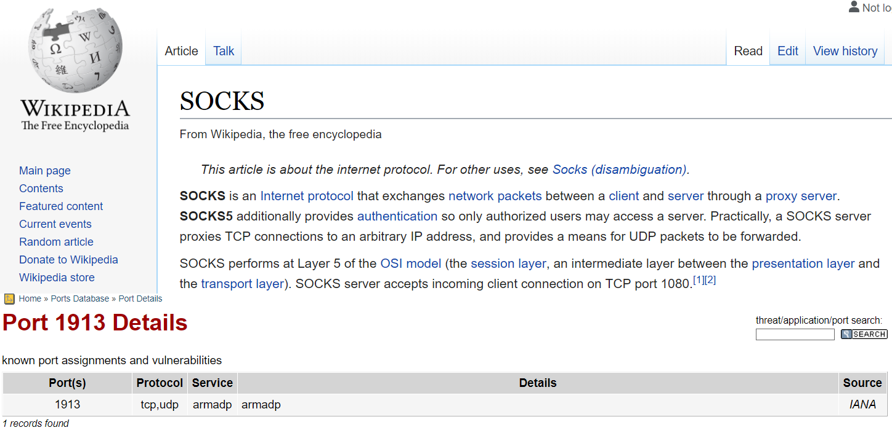
Detection: Research the Behavior

Slide 26
Detection: Translate the Behavior into a Tactic
What is the adversary trying to accomplish?
Often requires domain expertise
Finished intel can give you context
Only 12 options:
- Initial Access - Execution
- Persistence - Privilege Escalation
- Defense Evasion - Credential Access
- Discovery - Lateral Movement
- Collection - Command and Control
- Exfiltration - Impact

Slide 27
Detection: Translate the Behavior into a Tactic
“When executed, the malware first establishes a SOCKS5 connection to 192.157.198.103 using TCP port 1913. … Once the connection to the server is established, the malware expects a message containing at least three bytes from the server. These first three bytes are the command identifier. The following commands are supported by the malware … “
A connection in order to command the malware to do something
Command and Control

Slide 28
Detection: Translate the Behavior into a Tactic
Often the toughest part
Not every behavior is necessarily a technique
Key strategies:
Look at the list of Techniques for the identified Tactic
Search attack.mitre.org
Try key words
Try “procedure”-level detail
Try specific command strings

Slide 29
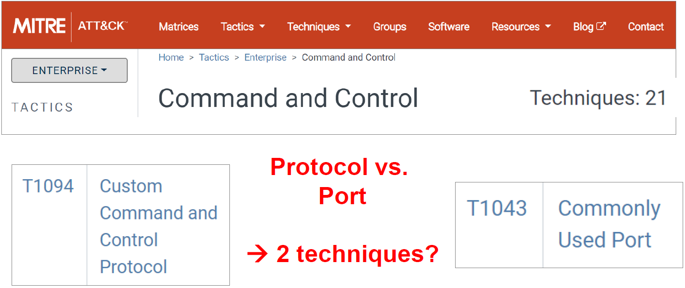
Detection: Translate the Behavior into a Tactic

Slide 30
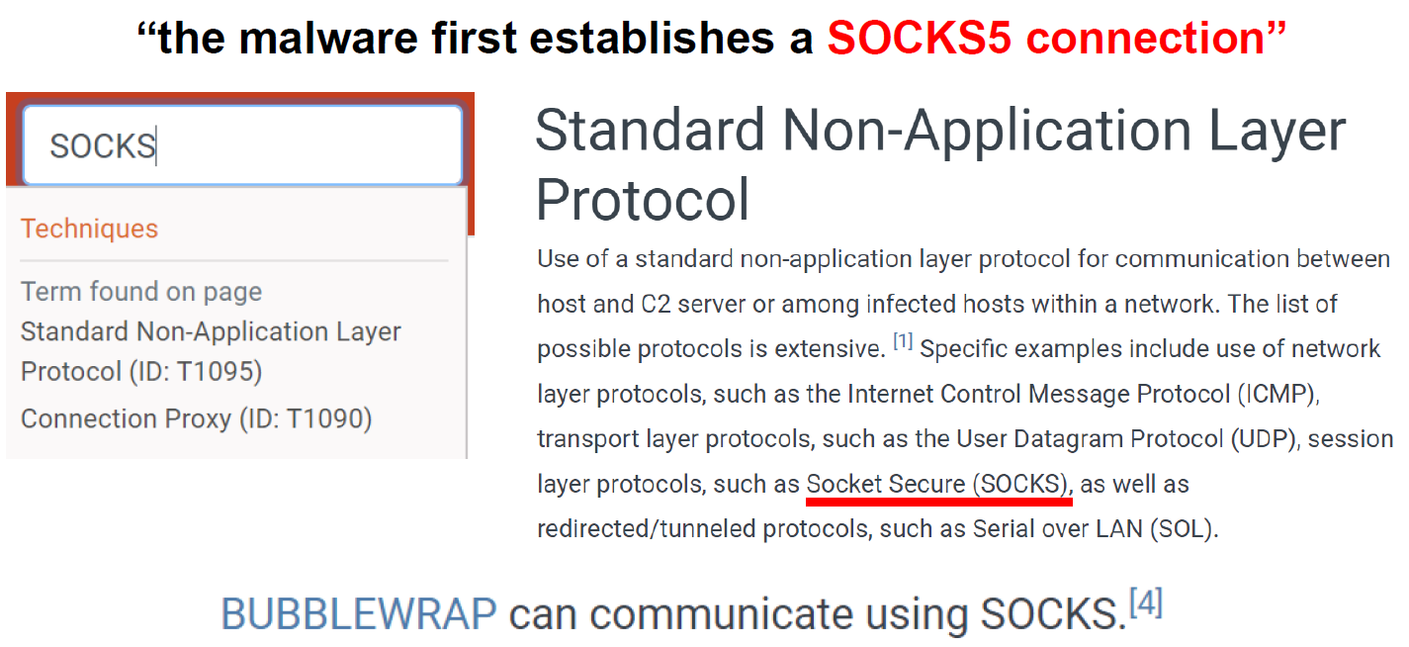
Detection: Translate the Behavior into a Tactic

Slide 31
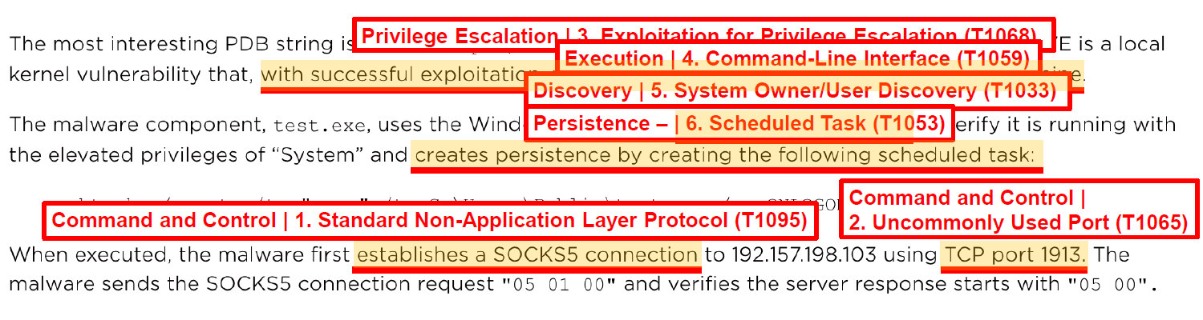
Detection: Translate the Behavior into a Tactic

Slide 32
Assessment and Engineering
Based on the type of visibility decisions should be driven on what you collect
What are the tools and technology you choose?
What is the current coverage?
Are the gaps identified?
Will they help you in building effective and efficient defenses?
Look at the bigger picture beyond detection
Increase awareness among the stake holders

Slide 33
Assessment and Engineering
Collect one log source at a time to improve ATT&CK visibility
Places to start:
rabobank-cdc/DeTTECT
https://github.com/rabobank-cdc/DeTTECT
Windows Event logs
https://www.malwarearchaeology.com/cheat-sheets
Sysmon
https://github.com/SwiftOnSecurity/sysmon-config

Slide 34
Example : DeTT&CT
DeTT&CT provides the following functionality:
Administrate and score the quality of your data sources.
Get insight on the visibility you have on for example endpoints.
Map your detection coverage.
Map threat actor behaviors.
Compare visibility, detection coverage and threat actor behaviors to uncover possible improvements in detection and visibility (which is based on your available data sources). This can help you to prioritize your blue teaming efforts.

Slide 35
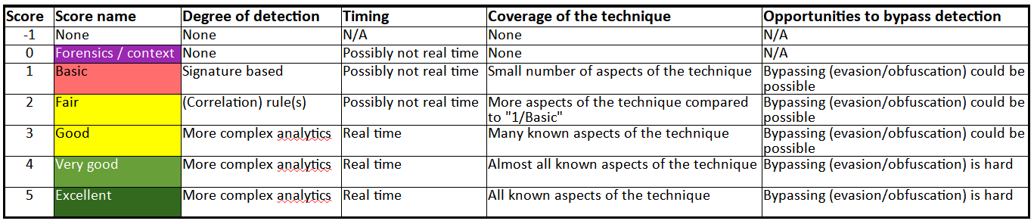
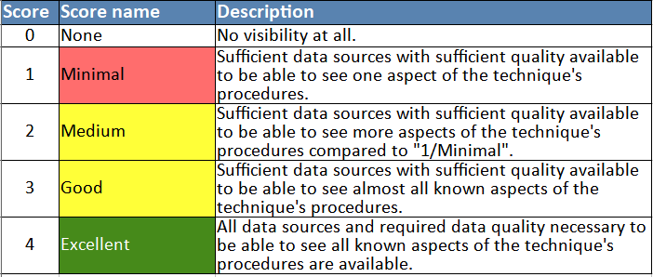
How to Score detection's for Assessment?

Slide 36
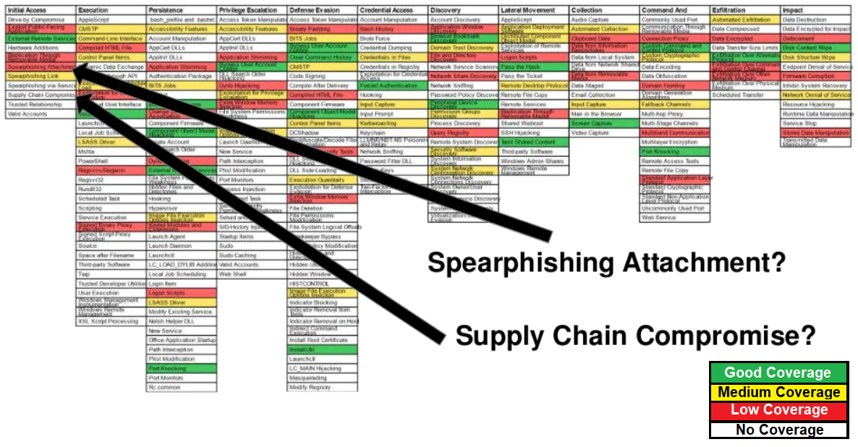
Assessment of the Gaps

Slide 37
Assessment and Engineering Conclusions
Plan out your tools and log monitoring strategy based on coverage
Determine what techniques your current logs and technology detect and remediate
Review the documentation
Check with the vendor
Identify what changes can be done to the environment
Configuration changes?
acquiring new detection tools?
map the gaps the tool can fill
Plan to use the resources based on the security budget

Slide 38
Thank you !!
and Keep using ATT&CK to DeTTECT ;)

